Slide 2
Level Designer, Storyteller
Building and supporting Narrative Through Level Design
Joel Burgess, Senior Designer, Bethesda Game Studios

Slide 3
What’s This, Then?
Not Platform/Unreal Specific
Just My Thoughts
There Will Be… Jargon.

Slide 4
A Brief Overview
LD/Player Relationship
LD role in storytelling
Cross-medium Techniques
Unique tools & methods
Doing a lot with little
Accepting Chaos

Slide 5
The Storyteller’s Tools
Language
Dialogue, Text, etc.
Visual Information
Layout, Clutter, Effects, et

Slide 6
Quick Writing Exercise
Player is a space Marine.
Lands at forward base.
Commander, Colonel (radio), Sarge
Convey Objective & Reward
Account for Budget
Sarge is Cut
12 Lines, 85 Char/Line
Re-Write! Active Storytelling
Lands Behind Enemy Lines
One Character Delivers Lines

Slide 7
What Did We Learn?
Game Development is Chaotic
Things outside your control change
Drafts Are a Good Thing
They expose what’s important
Function before Form

Slide 8
Using Language
Why use language?
Familiar
Direct
Unambiguous

Slide 9
Using Language
Traps of Language?
Tired Techniques
Localization Concerns
Verbosity
“Vigorous writing is concise.”
William Strunk Jr.
“Try to leave out the part that readers tend to skip.“
Elmore Leonard
“Brevity is the soul of wit”
Shakespeare

Slide 10
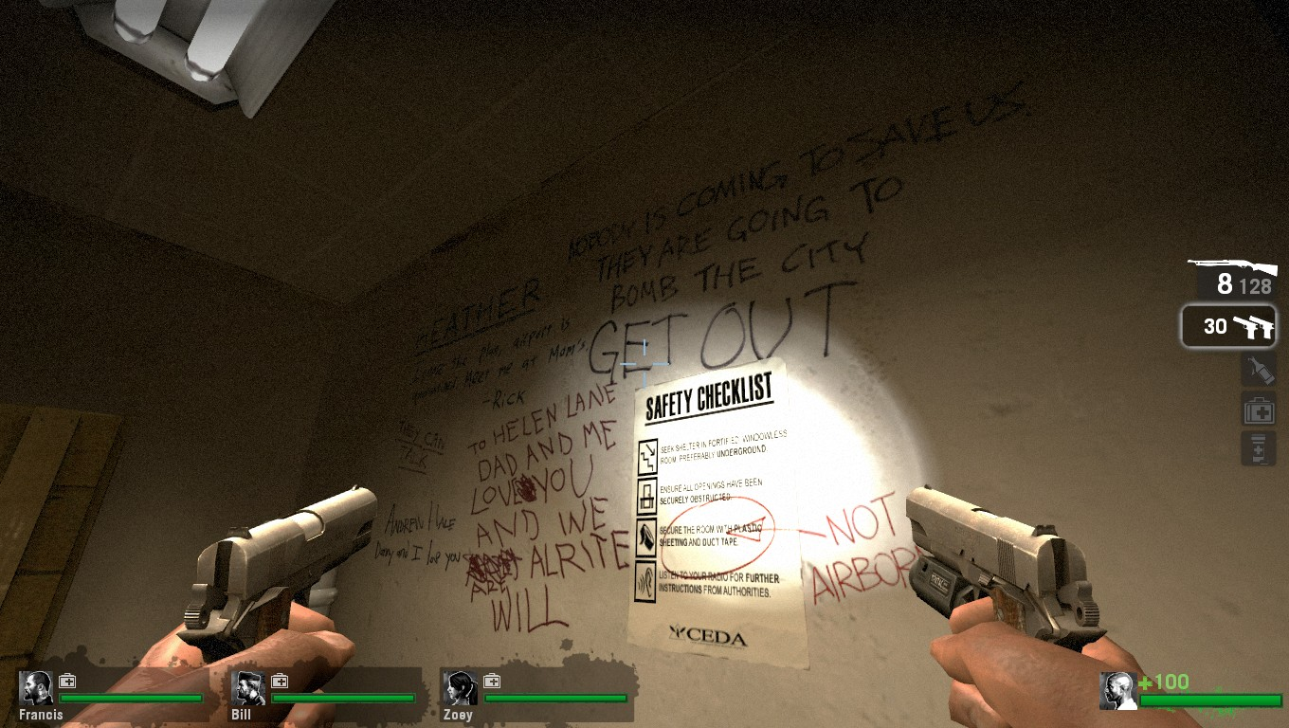
Using Language
Best Practice:
Brevity & Content Quality
Gameplay Info Before Style
In their own Words
Optional Static Text
Dialogue During Action
Left 4 Dead

Slide 11
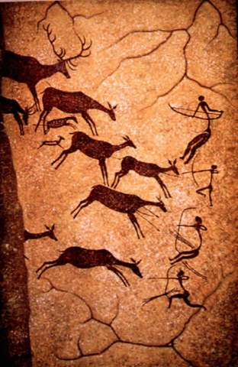
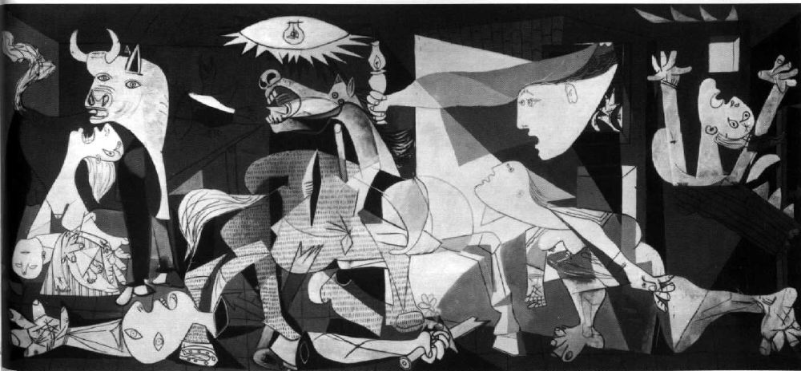
Visual Storytelling
Older than Language, after all…

Slide 12
Visual Information
Huge Array of Visual Tools:
Layout
Lighting
AI Behavior
Small Clutter
Particle FX
State Changes
Full Screen FX
Etc, etc…
Covering any of them in detail is beyond the scope of this conversation

Slide 13
Gestalt & the Player
Hard-Wired to Draw Conclusions
We crave order in what we see
Familiar Shapes most Recognizable
Lots of Gamer Demographics
But we’re all Humans.
Look for opportunities to use Gestalt

Slide 14
Gestalt & Level Design
Environments Tell Story Inherently
They Just Cannot Help Doing So!
So You Might As Well Use That
Collaborate with Art Often
Enable Team To Contribute
Your game will be richer
All that’s required is Oversight

Slide 15
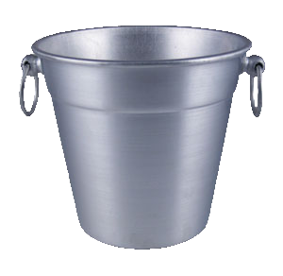
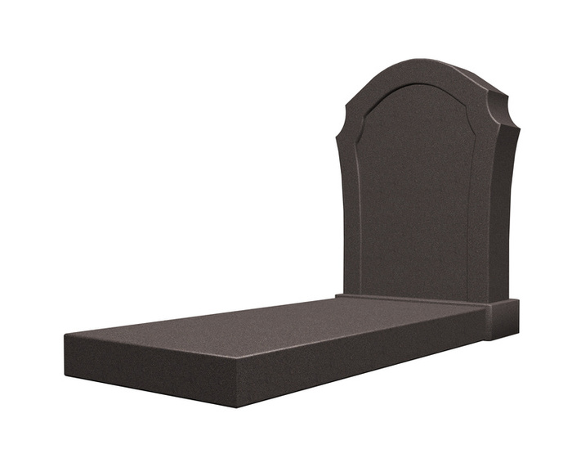
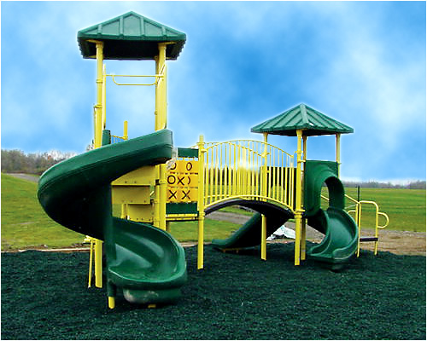
Snapshot Story

Slide 16
Exercise: Snapshot Story
View Unreal Room & Objects
On Paper, arrange objects in Room
Goal is to provide an interesting snapshot story using these elements

Slide 17
Putting It Together
Fallout 3 Radio Tower Example
Language (CB Radio Dialogue)
Gameplay Information (Static Ratio)
Snapshot Story (Small Clutter)
Gestalt (Player Story)

Slide 18
Accepting Chaos
Interactivity & The Medium
To exploit it, we must accept Chaos
Set Up Dominoes
Let the Player scatter them
Letting the Player Own Story
Don’t De-mystify
We are not those other guys
The Player is our Partner

Slide 19
Thanks For Listening
Some further reading suggestions:
“On Writing” Stephen King
“Designing Disney” John Hench
“Understanding Comics” Scott McCloud
“Kluge” Gary Marcus

